Slide 1
SQL VS NOSQL(MongoDB)
MySQL uses the Structured Query Language (SQL).
MySQL represents data in tables and rows.
MongoDB uses JavaScript as query language while MySQL uses the Structured Query Language (SQL).
MongoDB represents data as JSON documents.

Slide 2
SQL VS NOSQL(MongoDB)
INSERT INTO people(user_id,
age, status) VALUES ("bcd001",
45, "A")
ALTER TABLE people
ADD join_date DATETIME
ALTER TABLE people
DROP COLUMN join_date
db.people.insertOne(
{ user_id: "bcd001", age: 45, status: "A" }
)
db.people.updateMany(
{ },
{ $set: { join_date: new Date() } }
)
db.people.updateMany(
{ },
{ $unset: { "join_date": "" } }
)

Slide 3
SQL VS NOSQL(MongoDB)
SELECT * FROM people
SELECT id, user_id, status FROM people
SELECT *
FROM people
WHERE status = "A“
SELECT user_id, status
FROM people
WHERE status = "A"
db.people.find()
db.people.find(
{ },
{ user_id: 1, status: 1 }
)
db.people.find(
{ status: "A" }
)
db.people.find(
{ status: "A" },
{ user_id: 1, status: 1, _id: 0 }
)

Slide 4
SQL VS NOSQL(MongoDB)
SELECT *
FROM people
WHERE status != "A“
SELECT *
FROM people
WHERE status = "A"
AND age = 50
SELECT *
FROM people
WHERE status = "A"
OR age = 50
db.people.find(
{ status: { $ne: "A" } }
)
db.people.find(
{ status: "A",
age: 50 }
)
db.people.find(
{ $or: [ { status: "A" } , { age: 50 } ] }
)

Slide 5
SQL VS NOSQL(MongoDB)
SELECT *
FROM people
WHERE age > 25
SELECT *
FROM people
WHERE age < 25
SELECT *
FROM people
WHERE age > 25
AND age <= 50
db.people.find(
{ age: { $gt: 25 } }
)
db.people.find(
{ age: { $lt: 25 } }
)
db.people.find(
{ age: { $gt: 25, $lte: 50 } }
)

Slide 6
SQL VS NOSQL(MongoDB)
SELECT *
FROM people
WHERE user_id like "%bc%“
SELECT *
FROM people
WHERE status = "A"
ORDER BY user_id ASC
db.people.find( { user_id: /bc/ } )
-or-
db.people.find( { user_id: { $regex: /bc/ } } )
db.people.find( { status: "A" } ).sort( { user_id: 1 } )

Slide 7
SQL VS NOSQL(MongoDB)
SELECT *
FROM people
WHERE status = "A"
ORDER BY user_id DESC
SELECT COUNT(*)
FROM people
SELECT COUNT(user_id)
FROM people
db.people.find( { status: "A" } ).sort( { user_id: -1 } )
db.people.count()
or
db.people.find().count()
db.people.count( { user_id: { $exists: true } } )
or
db.people.find( { user_id: { $exists: true } } ).count()

Slide 8
SQL VS NOSQL(MongoDB)
SELECT COUNT(*)
FROM people
WHERE age > 30
SELECT DISTINCT(status)
FROM people
SELECT *
FROM people
LIMIT 1
db.people.count( { age: { $gt: 30 } } )
or
db.people.find( { age: { $gt: 30 } } ).count()
db.people.aggregate( [ { $group : { _id : "$status" } } ] )
or
db.people.distinct( "status" )
db.people.findOne()
or
db.people.find().limit(1)

Slide 9
SQL VS NOSQL(MongoDB)
SELECT * FROM people LIMIT 5 SKIP 2
db.people.find().limit(5).skip(2)

Slide 10
SQL VS NOSQL(MongoDB)
UPDATE people SET status = "C"
WHERE age > 25
UPDATE people
SET age = age + 3
WHERE status = "A“
DELETE FROM people
WHERE status = "D“
DELETE FROM people
db.people.updateMany(
{ age: { $gt: 25 } },
{ $set: { status: "C" } }
)
db.people.updateMany(
{ status: "A" } ,
{ $inc: { age: 3 } }
)
db.people.deleteMany( { status: "D" } )
db.people.deleteMany({})

Slide 11
SQL VS NOSQL(MongoDB)
DROP TABLE people
db.people.drop()

Slide 12
SQL VS NOSQL(MongoDB)
update mydb
set VALORE_01 = 5.5
where NUM = -1;
db.mydb.update(
{"NUM" : -1},
{ $set : { "VALORE_01" : 5.5}
});

Slide 13
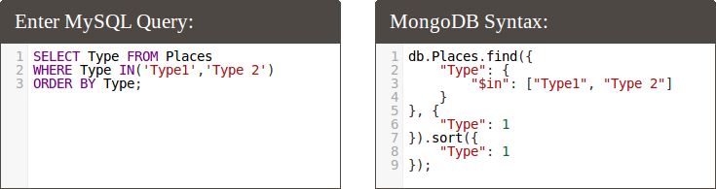
MongoDB CRUD Operations

Slide 14
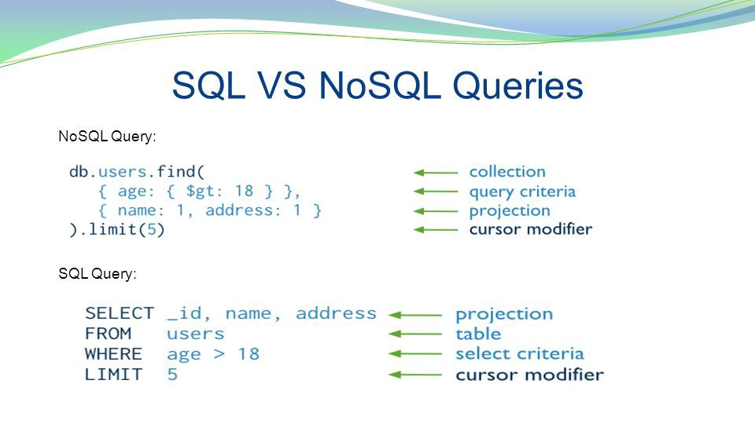
MongoDB CRUD Operations

Slide 15
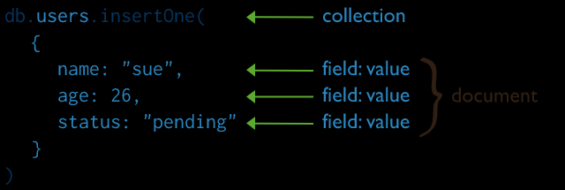
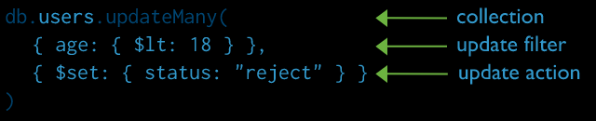
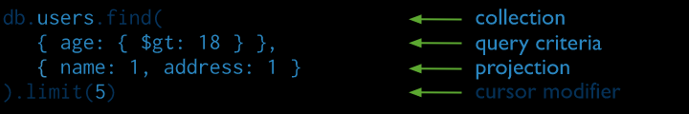
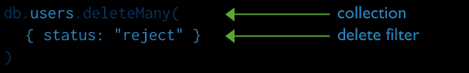
SQL VS NOSQL(MongoDB)
MongoDB CRUD Operations

Slide 16
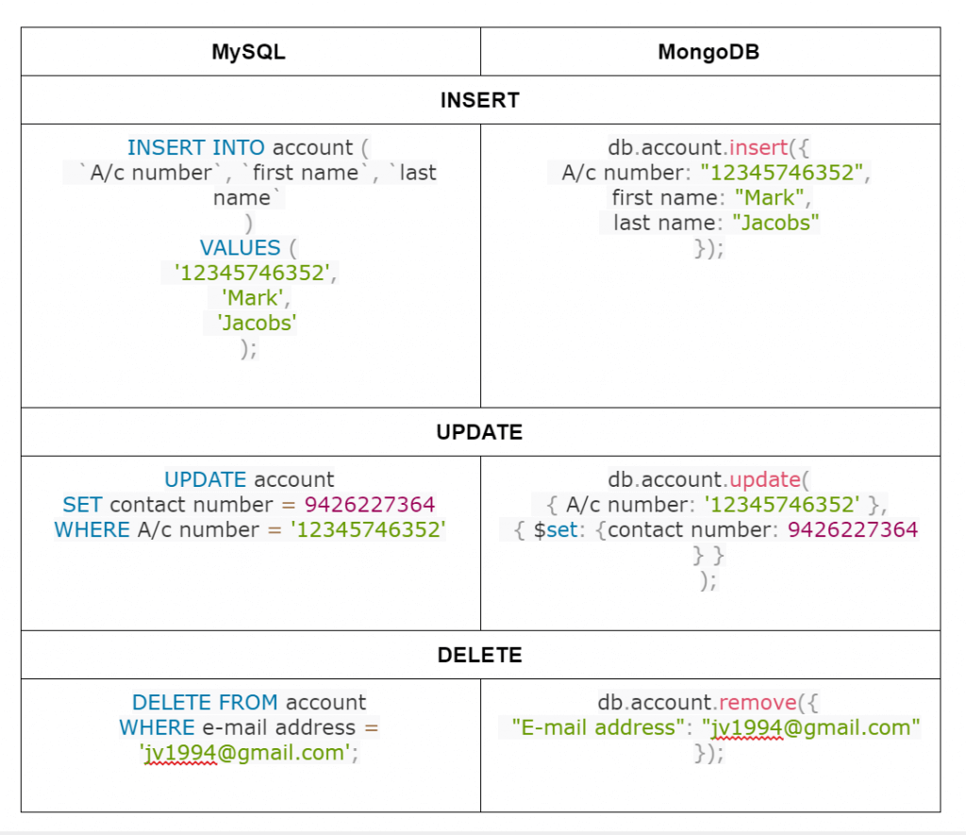
MongoDB CRUD Operations

Slide 17

SQL VS NOSQL(MongoDB)

Slide 18

SQL VS NOSQL(MongoDB)

